Slide 1
About Trainer
I am Anand, B.E - Computer Science graduate
Having 25+ Years of experience in IT sector
Worked for MNC(Wipro, Sun, Adobe, EMC, Cisco)
Vast experience in Banking, HealthCare, Data Center, Content Management software’s
Certified Scrum Master, Cisco CCNA, AWS Solution Architect

Slide 2
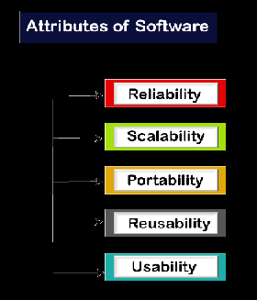
Software Testing
What is Software Testing
Software testing is a process of identifying the correctness of software by considering its all attributes (Reliability, Scalability, Portability, Re-usability, Usability) and evaluating the execution of software components to find the software bugs or errors or defects.
SOFTWARE TESTING is defined as an activity to check whether the actual results match the expected results and to ensure that the software system is Defect free

Slide 3
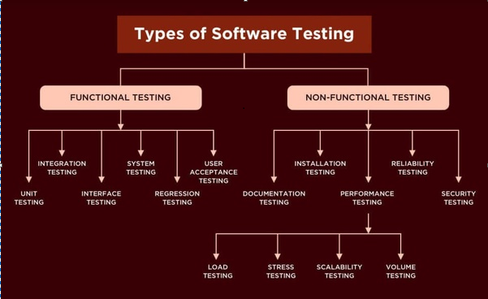
What is Testing
Testing is a group of techniques to determine the correctness of the application under the predefined script but, testing cannot find all the defect of application.
The main intent of testing is to detect failures of the application so that failures can be discovered and corrected.
It does not demonstrate that a product functions properly under all conditions but only that it is not working in some specific conditions.
Type of Software testing

Slide 4
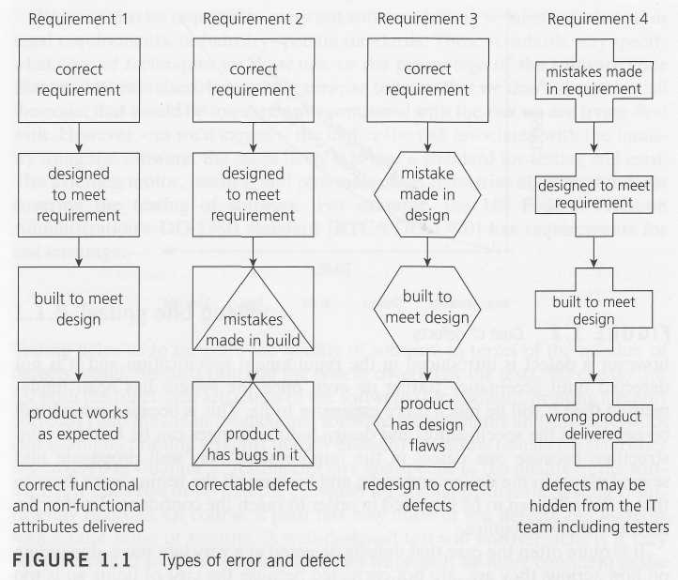
When do defects arise?

Slide 5
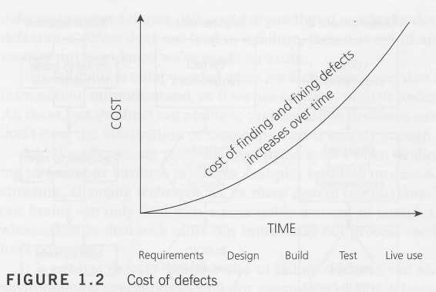
What is the cost of defects?

Slide 6
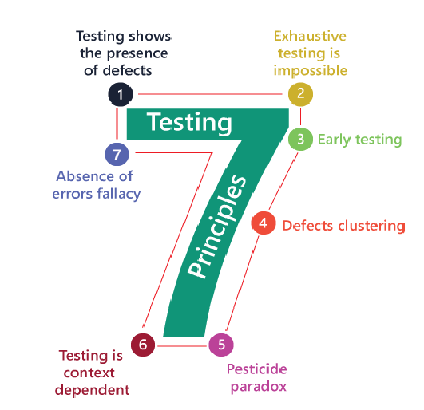
Software Testing Principles

Slide 7
Software Development Life Cycle (SDLC)
SDLC describes various phases of software development and the order of execution of phases.
Each phase requires deliverable from the previous phase in a life cycle of software development.
Requirements are translated into design, design into development and development into testing; after testing, it is given to the client.

Slide 8
Software Test Life Cycle (STLC)
1. Understand the requirement
2. Test Planning (Agile process, not much importance for TP)
3. scenarios to be tested
4. Test cases to be written based on the scenarios
4a. Peer Review of the Test Cases for corrections/additions
5. Test Execution
6. Identify Defects & report to the developer
7. closure
Functional Requirements
1. Functional Requirement Document (FRS) / User stories in Agile
2. Identify Test Scenarios
3. Test Cases

Slide 9
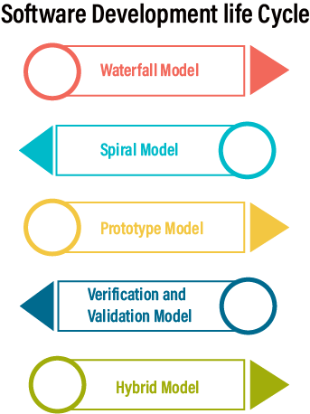
Software Development Life Cycle (SDLC) Models

Slide 10
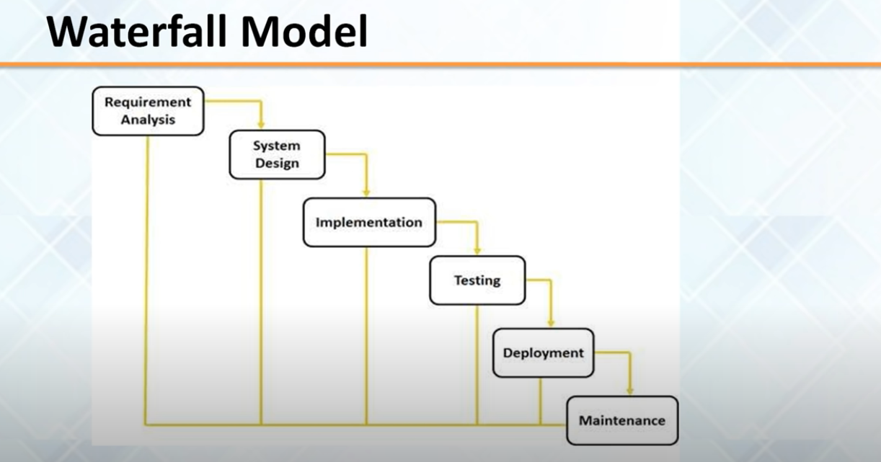

Slide 11
